Slide 1



GO Team
Business Meeting #2
Where we are – Where we’re going
One District. One Goal. Every Child.

Slide 2

Agenda
Call to Order
Roll Call; Establish Quorum
Action Items (add items as needed)
  Approval of Agenda
  Approval of Previous Minutes
  Approval of vacant Community Member Seat
  Approval of vacant Swing Seat
  Approval of vacant Student Seat
Discussion Items
  Graduation Rate
  2025-2030 Strategic Plan Development
Information Items
  Principal’s Report
  APS Forward 2040 –Comprehensive Long-Range Facilities Plan Update
Announcements (add items as needed)
Adjournment
2

Slide 3



Action Items
Approval of Agenda
Approval of Previous Minutes
Approval of vacant Community Member Seat
Approval of vacant Swing Seat
Approval of vacant Student Seat

Slide 4
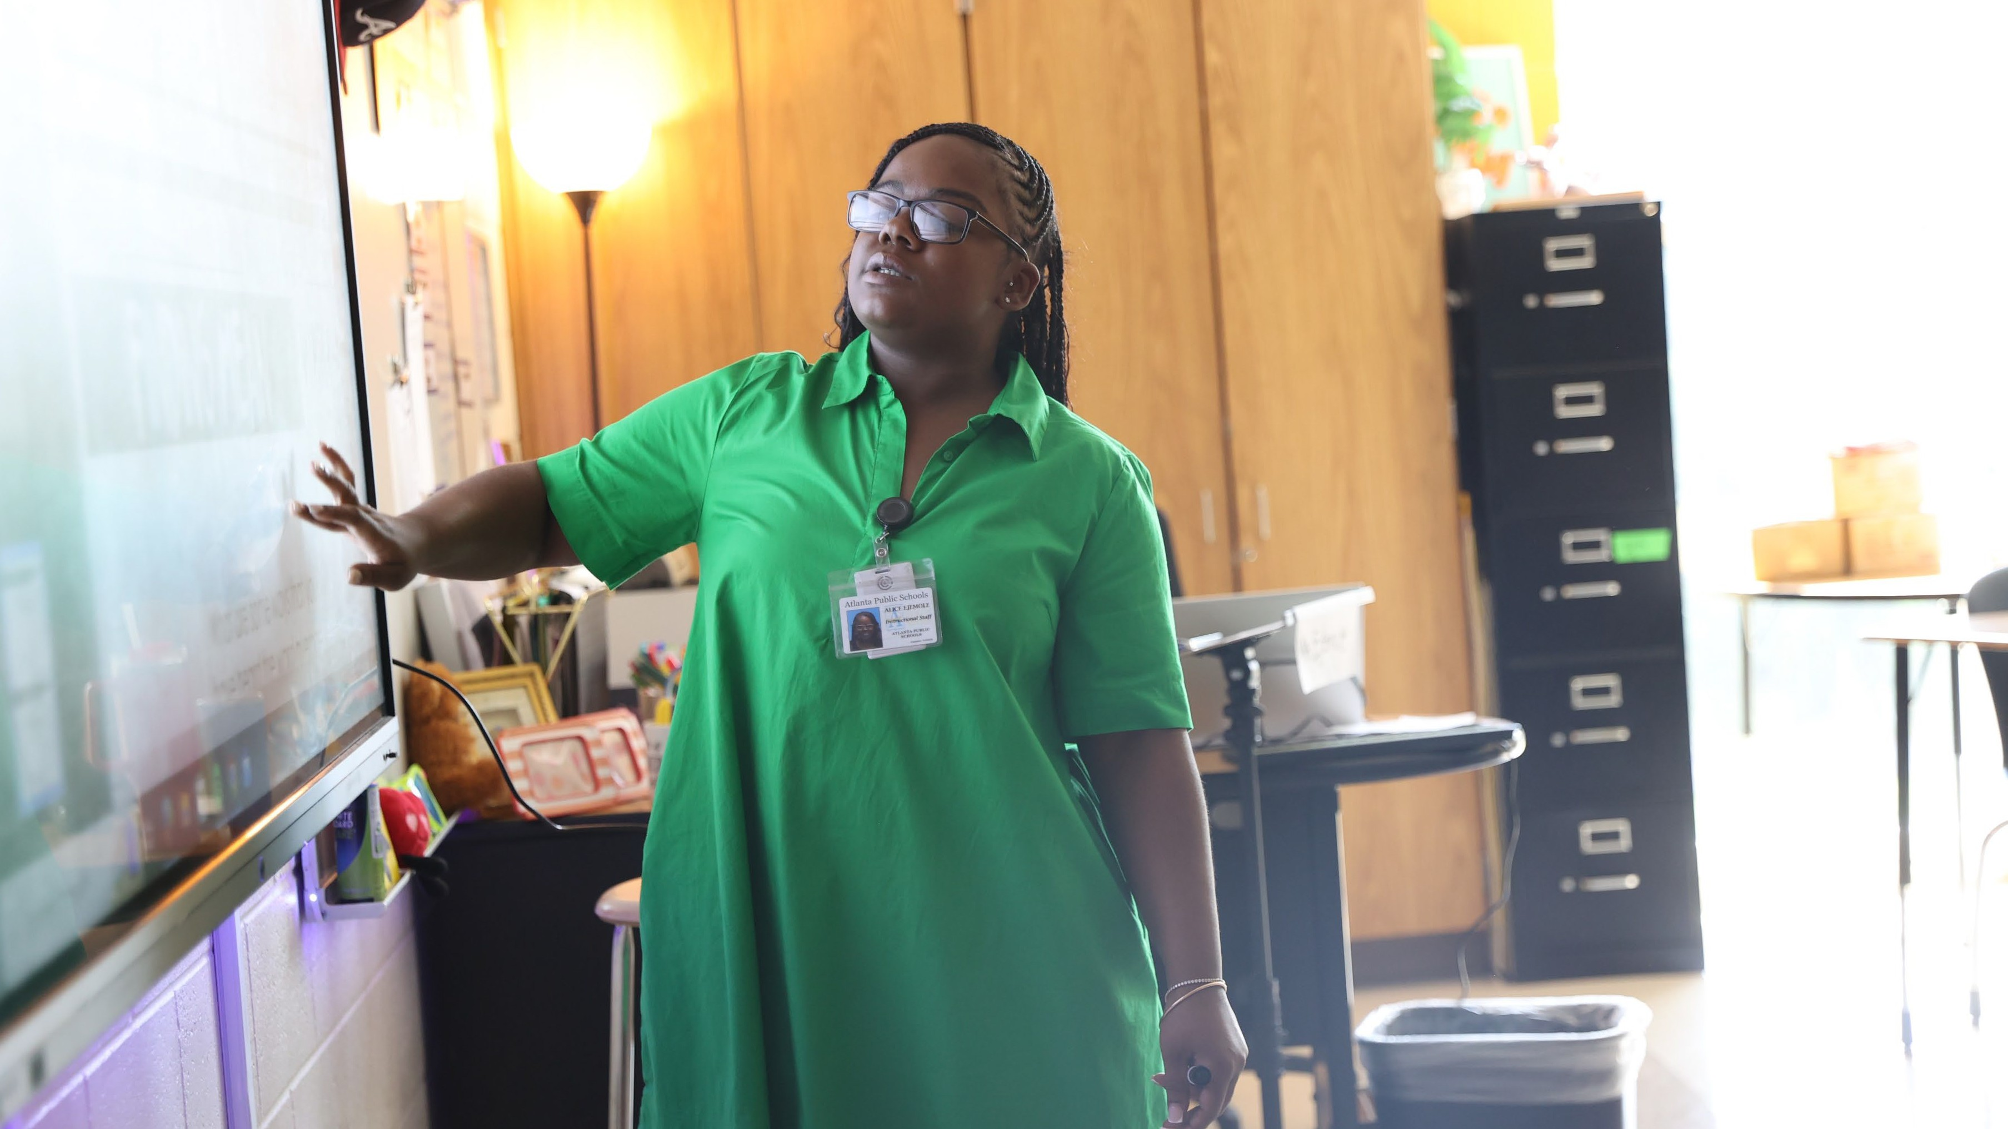

Discussion Items
One District. One Goal. Every Child.

Slide 5

GRADUATION RATE
Cohort 2025- 86.5% (Actual)
Cohort 2026- 90.5% (Goal)
10/3/2025
5

Slide 6

2025-2030
School Strategic Plan Development

Slide 7
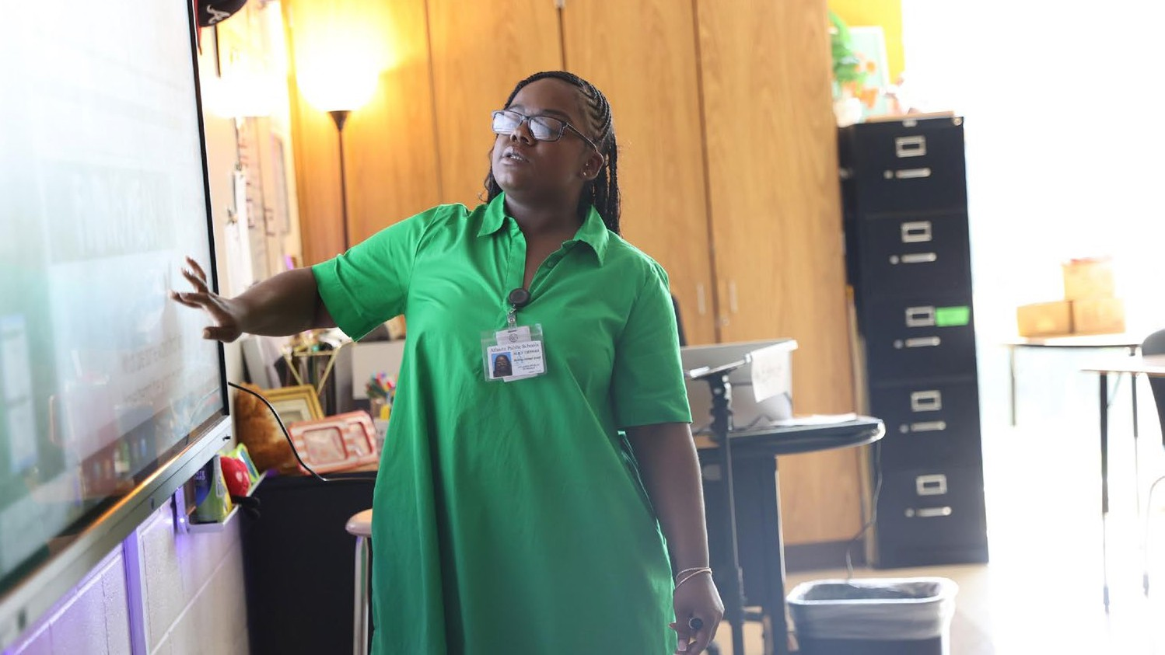


Atlanta Public Schools 2025-2030 Strategic Plan
One District. One Goal. Every Child.

Slide 8
We are Atlanta’s Public School System
To educate and empower Atlanta’s students to shape the future
8

Slide 9

A COMMUNITY OF BELIEVERS GETTING BACK TO BASICS
Our Strength is Our Team
Atlanta’s students will have effective and engaged teachers, leaders, and staff.
Increase concentration of highly-effective teachers and leaders
Prioritize engagement and retention for staff
Grow and promote strong teachers, leaders, and staff
Our Responsibility Is Shared
Atlanta’s students will have supportive families, communities, and partners.
Build meaningful partnerships
Expand Atlanta Partners for Education (APFE) impact
Increase access and engagement for families and communities
We Are Strengthening Our Instructional Core
Atlanta’s students will have high-quality instruction, materials, and targeted support.
Implement high-quality, relevant, and engaging instructional materials and professional learning in all core content areas
Target resources towards subgroups (eg. exceptional education, English learners, economically-disadvantaged)
Accelerate early learning
We Are Caring For Every Child
Atlanta’s students will have trusted, supportive adults meeting their unique needs.
Expand strategies that reduce chronic absenteeism and disproportionate discipline
Implement systematic culture and climate strategies
Increase student access to trusted and reliable adults (eg. mentors, coaches, counselors)
Our System Is Efficient & Effective Atlanta’s students will have the schools and resources they need to succeed.
Maximize facility usage for the student and community good
Leverage data to drive strategic financial investments
Implement sustainability initiatives
We Are Sparking Student Curiosity
Atlanta’s students will have access to explore and expand their passions and interests.
Promote robust arts, athletics, world language, and enrichment offerings
Expand access to high-interest and workforce-ready offerings (e.g. career programs and pathways, advanced coursework)
Explore specialized and innovative school models (eg. School of the Arts)
9

Slide 10
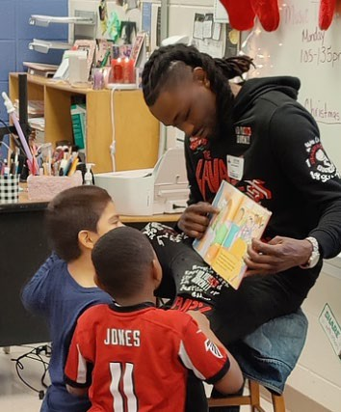
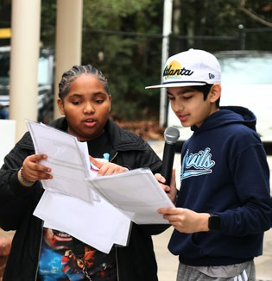

Goals and Key Performance Indicators
Focus Area:
We Are Caring For Every Child
By 2030, we will increase the percentage of 3rd grade students scoring proficient or above in ELA (GA Milestones) by 20 percentage points.
Actual (2025)
Light pink: 2024
Target (2030)
68.8% | Absenteeism % of students who are not chronically absent* | 80%
60% | Sense of Belonging % students who feel a sense of belonging* | 75%
89.6% | Discipline: All Students % of all students without suspensions (OSS) * | 95%
83.5% | Discipline: Students with Disabilities % of Students with Disabilities students without suspensions (OSS)* | 95%
86.4% | Discipline: Black Students % of Black students without suspensions (OSS)* | 95%
56% | Student-Staff Relationships % of students feeling comfortable going to most or all of the adults in the school for help* | 75%
0% | Student Success Plans % of students with individual success plans | 90%
19% | School Climate % of schools with 4 or 5 star climate rating* | 50%
By 2030, we will increase the percentage of 8th grade students scoring proficient or above in Math (GA Milestones) by 20 percentage points.
By 2030, we will increase the percentage of students meeting at least one CCRPI College and Career Readiness Indicator by 20 percentage points.
* Includes Charter and Partner Schools
10

Slide 11
GO Team School Strategic Plan Development
One District. One Goal. Every Child.

Slide 12

Mission Vision
What is our purpose? What do we do?
What is our picture of the future?
We are educating and empowering Atlanta’s students to shape the future.
Literacy
Numeracy
College & Career Readiness
Strategic Goals
What results do we want to satisfy our stakeholder needs?
Focus Areas
What are the main focus areas (“Pillars of Excellence”) of our work?
We are Caring for Every Child
(example)
Expand strategies that reduce chronic absenteeism (example)
% of students who are not chronically absent (example)
Objectives
What continuous improvement activities are needed to get results?
Governance
Key Performance Indicators
How will we evaluate performance to know if we are achieving the results we want?
Strategies
What high-leverage strategies will lead to the desired results?
Implement Multi-Tiered Systems of Support (MTSS) (example)
Monthly, provide consistent communication with all families on the importance of attendance and supports available (example)
Actions
Who will do what by when?
Management
7/8/2025 12
Notes:
This is the funnel or how the district and schools are developing their strategic plan.
At the end result of the strategic plan process is to create focus areas and objectives. For every objective there should be a key performance indicator (KPI) that measures it.

Slide 13
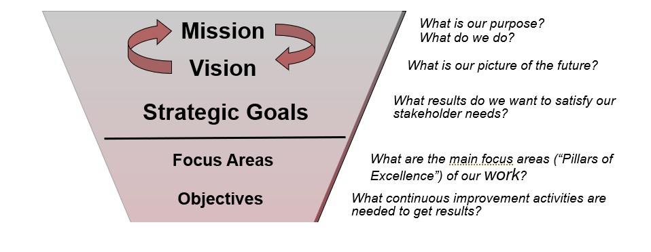
GO Team Focus (Governance)
Notes:
This is our focus as a GO-Team

Slide 14
School Strategic Planning Overview
Purpose
To cascade the district strategic plan to the school level, while grounding our focus in the school’s Continuous Improvement Plan. This will create alignment, reduce confusion, and simplify our efforts.
Timeline
Our school’s 2030 Strategic Goals and Objectives should be updated, approved and ranked by January 2026. Schools will focus on the strategies as part of FY27 Budget and Continuous Improvement Plan processes.

Slide 15



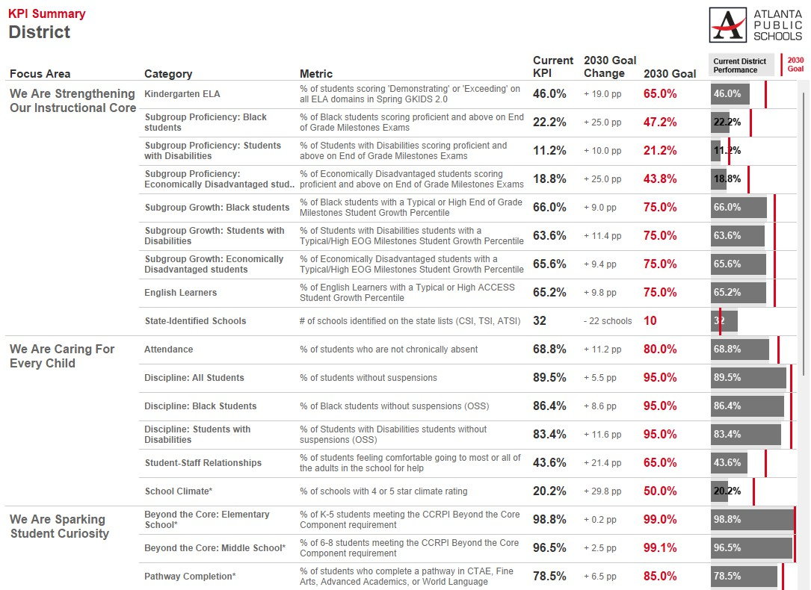
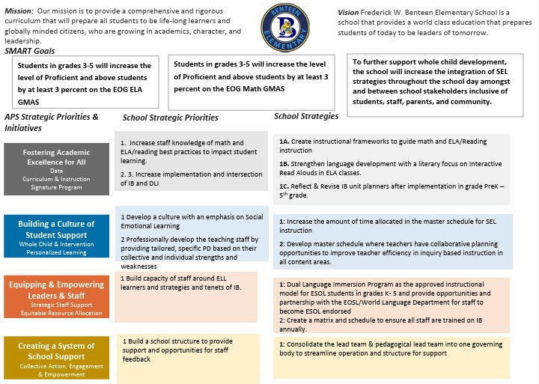
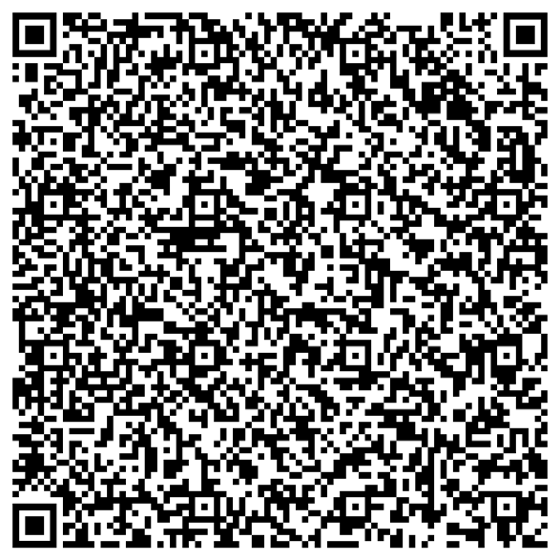

Three Key Resources to Review
1
2020-2025 School Strategic Plan
2
2025-2026 Continuous Improvement Plan Goals
3
School Data Sheet
https://tinyurl.com/SchoolDataSheets
By the end of the 2025 - 2026 school year, Benteen will increase the CCRPI Attendance by at least 6.6% points from 83.4% to 90%.
By the end of the 2025 - 2026 school years, Benteen will increase the percent of students scoring proficient and above on the GMAS assessments in math by 5%, from 35% to 40%. Benteen will decrease the percent of students scoring beginning on the GMAS assessment in math by 3%, from 38 to 35%.
By the end of the 2025 - 2026 school year, Benteen will increase the CCRPI Attendance by at least 6.6% points from 83.4% to 90%.
Use the QR code to access all school data sheets
15
Notes:
What we're going to be reviewing

Slide 16
Today’s Focus:
School Strategic Planning Process: Steps 1, 2, and 3
1
Sample GO Team Business Meeting Cadence
Business Meeting 1:
Review Data (MAP, GMAS, Graduation Rate, CCRPI, etc.)
Business Meeting 3:
Identify 2025-2030 Strategic Objectives
Business Meeting 4 (Budget Allocation):
Approve Your Strategic Plan & Rank Your Strategic Objectives for FY27
Review Data
2
Align Mission/Vision/Purpose
Business Meeting 2:
Review Data (School KPIs)
Align Mission/Vision/ Purpose
Confirm 2030 Goals
3
Confirm 2030 Goals
Create CIP Goals to 2030
Identify Additional Goals
4
Identify 2025-2030 Strategic Objectives
Reflect on 2020-2025 Strategic Plan
Review and Discuss Additional Objectives Going Forward
Approve Your Strategic Plan & Rank Your Strategic Objectives for FY27
5
17

Slide 17
1. Review Data
One District. One Goal. Every Child.

Slide 18
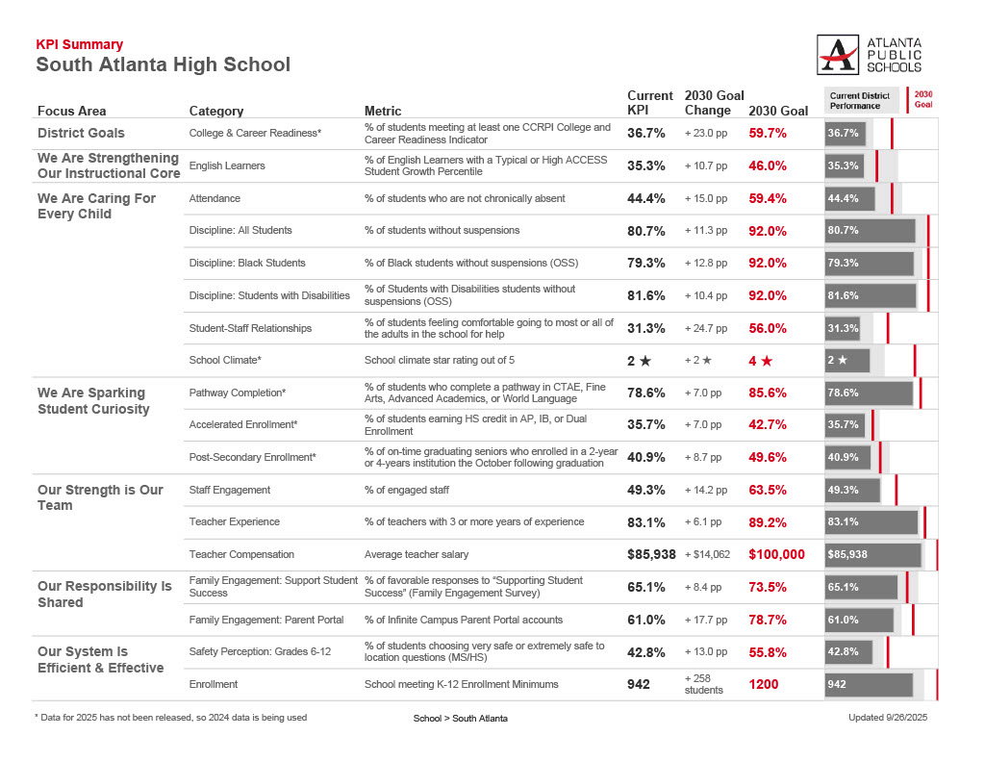
Guiding Questions for the GO Team to Discuss:
What do you notice?
What are your wonderings?
Are you on track?
Are there specific sub-group performance gaps?
Outside of the “Instructional Core,” what could be a focus area?
Notes:
This is a slide for us to look at, what do we see, what do we wonder. Does it look it we are on-track with meeting the KPI's.
Is there anything from here that we should use to inform our goals for 2025-2030

Slide 19
2. Align Mission/Vision/Purpose
One District. One Goal. Every Child.

Slide 20

We are Atlanta’s Public School System
Note:
Your GO Team will decide if they would like to update the school mission, vision, or purpose statements. Use this slide and a combination of the next 2 slides to display your school’s current mission and vision, and lead your team in the discussion.
Potential Activity: Share the current school mission/vision. Ask GO Team members to hold up fingers to indicate their level of satisfaction with the current mission and vision (5=Love it, 0=Strongly Dislike). Proceed with the discussion based on the team’s feedback.
To educate and empower Atlanta’s students to shape the future
21

Slide 21
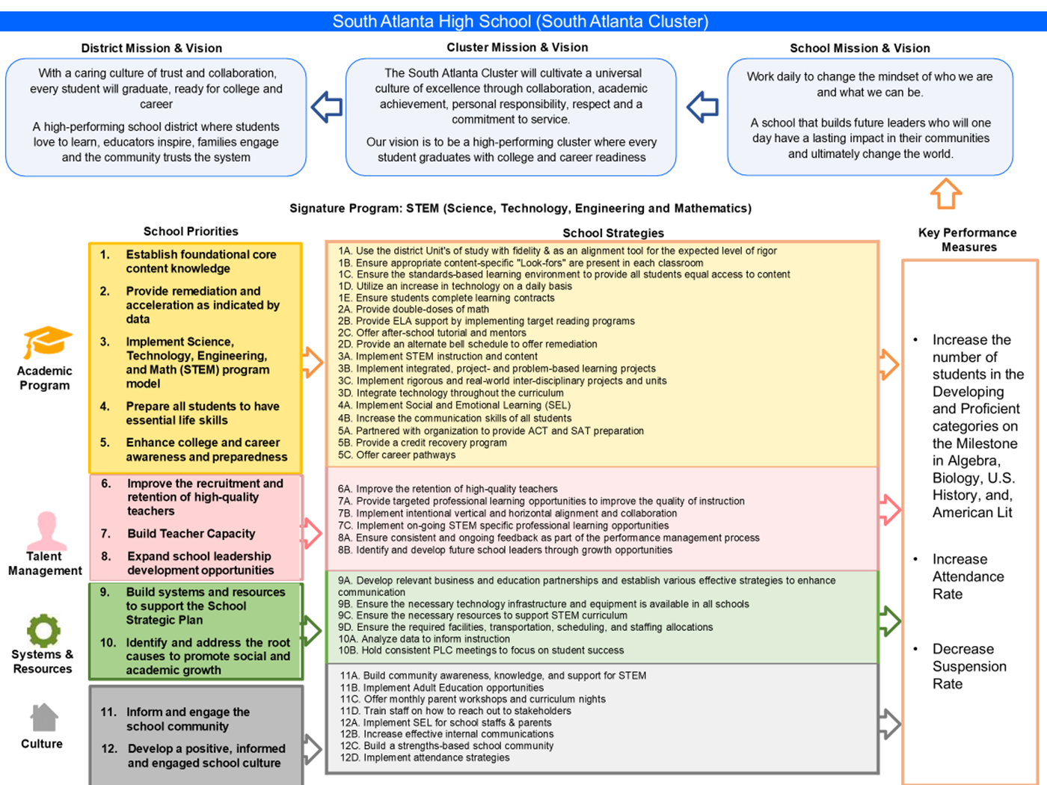

Slide 22


Mission and Vision Alignment:
We are Atlanta’s Public School ^{To educate and empower} _{System} Atlanta’s students to shape the
future
Guiding Question: Does our current school mission and vision align with these statements?
Vision: A school that builds future leaders who will one day have a lasting impact in their communities and ultimately change the world
Mission: Work daily to change the mindset of who we are and what we can be

Slide 23
Proposed Updates to School Mission and Vision:
Enter proposed changes to the school mission and vision here based on the GO Team’s discussion.
Notes:
Here is where we would talk about updates to the exisitng school mission and vision

Slide 24
3. Confirm 2030 Goals
Extend your Continuous Improvement Plan Goals to 2030
Identify if there are any additional goals for the strategic plan beyond those identified. If so, capture them (no more than 1-2 additional goals)
One District. One Goal. Every Child.

Slide 25
2030 Strategic Plan Goals
By May 2026, South Atlanta High School will increase its CCRPI attendance rate from 42.1% (SY 24-25) to 49.1% (SY 25-26) by implementing and promoting daily attendance incentives to encourage consistent student attendance.
By May 2026, the percentage of students scoring Developing or above on the Spring 2026 Literature and Composition II End-of-Course (EOC) assessment will increase from 41% to 46% overall.
By May 2026, the percentage of all students scoring Developing or above on the Spring 2026 Algebra I: Concepts and Connections End-of-Course (EOC) assessment will increase from 47% to 52%.
By May 2026, South Atlanta High School will increase the graduation rate from 89% (as of August 2025) to 91%, ensuring more students meet all graduation requirements on time.
By the end of the 2025–2026 school year, 57% of South Atlanta High School Cohort 2026 students will achieve at least one College and Career Readiness Indicator (CCRPI) as defined by the Georgia Department of Education.
By May 2030 , South Atlanta High School will increase its CCRPI attendance rate from 42.1% (SY 24-25) to XX.XX% by implementing and promoting daily attendance incentives to encourage consistent student attendance.
By May 2030, the percentage of students scoring Developing or above on the Spring 2030 Literature and Composition II End-of-Course (EOC) assessment will increase from 41% to XX% overall
By May 2026, the percentage of all students scoring Developing or above on the Spring 2030 Algebra I: Concepts and Connections End-of-Course (EOC) assessment will increase from 47% to XX%.
By May 2030, South Atlanta High School will increase the graduation rate from 89% (as of August 2025) to XX%, ensuring more students meet all graduation requirements on time.
By 2030, XX% of South Atlanta High School Cohort 2030 students will achieve at least one College and Career Readiness Indicator (CCRPI) as defined by the Georgia Department of Education.
Notes:
We need to talk through what the percentages would be for the 2030 goal?

Slide 26
Guiding Question: After reviewing our current Strategic Plan and school KPIs, are there any additional goals we would like to include with our 2030 CIP Goals for the 2025-2030 Strategic Plan? (No more than 1-2 additional goals)
Enter any proposed additional goals for the strategic plan that the team identifies here.
Notes:
We'll use this slide if there are additiional goals the team wants to consider.

Slide 27
Strategic planning will help you fully uncover your available options, set priorities for them, and define the methods to achieve them.
Robert J. Mckain
29
Notes:
This is just a fluff slide, to make the presentation look nice.

Slide 28

Questions?
10/3/2025
30

Slide 29
Principal’s Report
One District. One Goal. Every Child.

Slide 30
SCHOOL UPDATES
Instruction
Talent Reviews Completed
Our Primary Instructional Focus (Academic Monitoring)
Safety Security
SRO schedule change
10/3/2025 33

Slide 31
SCHOOL UPDATES
Facilities
Construction Updates
Roof renovation
Gym renovation
Counselor's suite update
HR
Part-Time Grad. Coach hired
Restorative Practice Coach recommended to HR
10/3/2025 33

Slide 32














APS Forward 2040: Reshaping the Future of Education
Comprehensive Long-Range Facilities Plan
atlantapublicschools.us/APS2040
Taskforce Meetings
May 8, 2025 - Presentation
August 5, 2025- Presentation
Upcoming Public Meetings
October 20
November 10
Virtual – at Noon
In-person at 6PM at CLL (130 Trinity Ave)

Slide 33
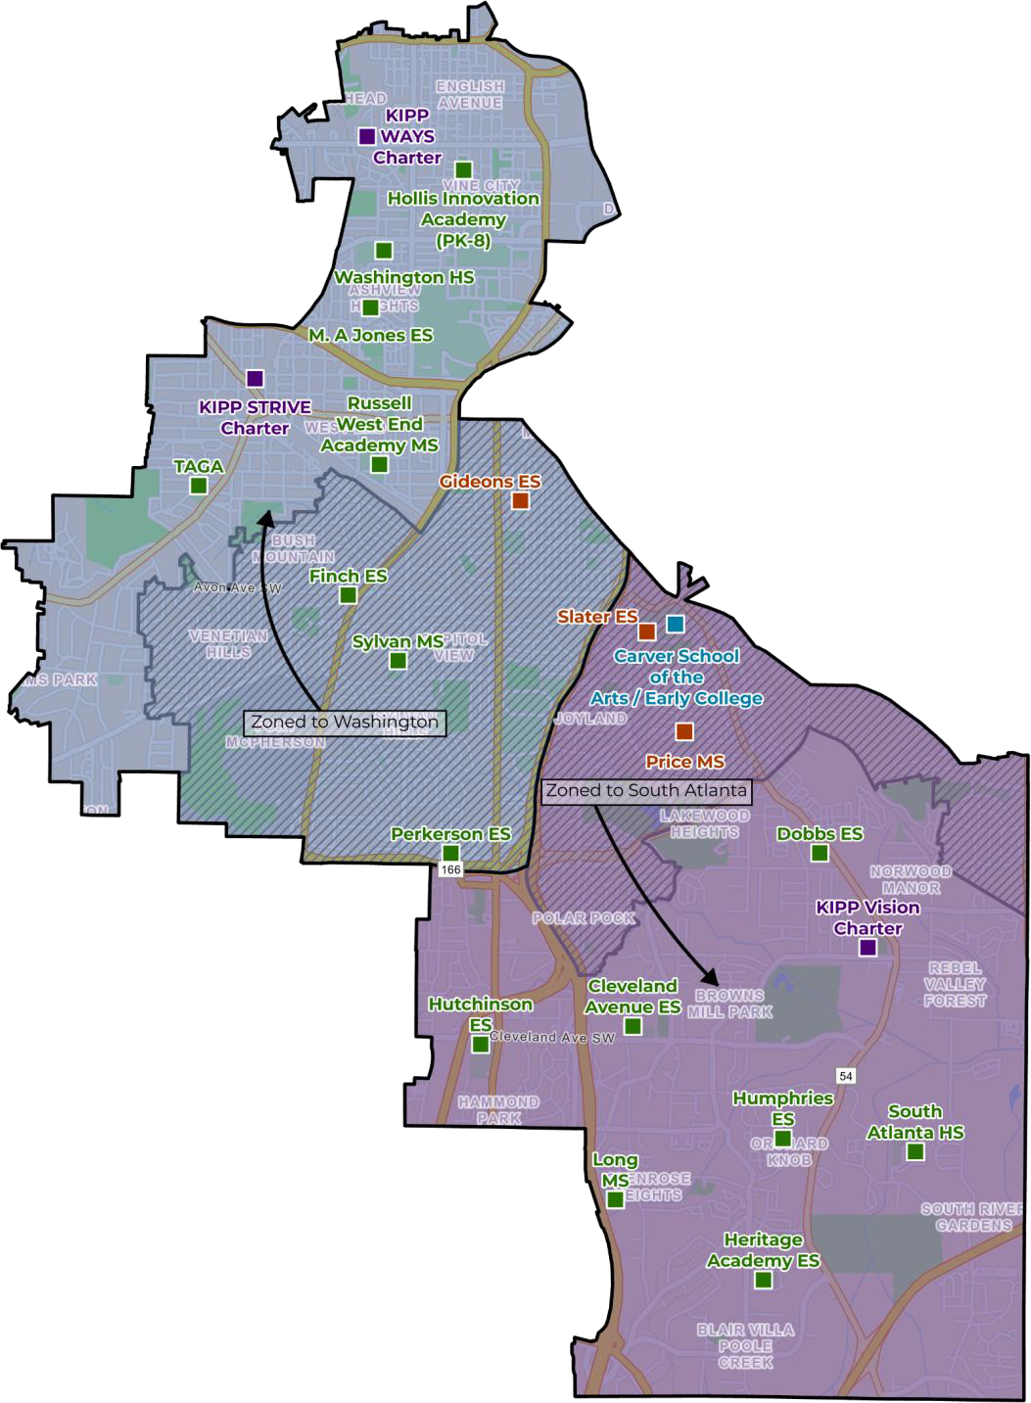


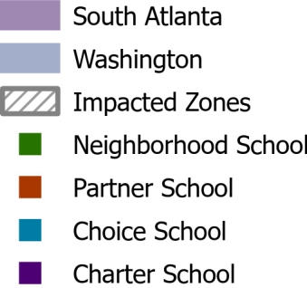

Carver HS – Primary Scenario ESPLOST DEPENDENT
Re-Imagine Carver High School – District-wide School of the Arts (6-12) & Early College HS (9-12)
Carver Early College Facility converts to 6th-12th grade District-wide School of the Arts & Early College HS (SPLOST Dependent)
Preference will be given to students in the current Carver zone
Probable phase-in by grade
Upon end of STEAM PBSA agreement - School of Arts & Early College
expands to entire Carver campus
Programs
Explore locations for centralizing BEST/CSK with repurpose of facility in Carver/Washington/Jackson Clusters
Carver HS Facility Converted to Atlanta School of the Arts at Carver High & Early College HS
Condition & Program Renovations
Potential relief for Jackson and Midtown Clusters
Sylvan MS converted to an elementary school for Finch and Perkerson
ES
Facility
Carver HS attendance areas moved to South Atlanta and Washington Clusters
Finch, Gideons, & Perkerson Elementary schools rezoned to the Washington Cluster.
Finch & Perkerson ES combined at converted Sylvan MS
Sylvan MS students move to Russell West End MS in Washington
Cluster
Slater ES & Price MS rezoned to South Atlanta Cluster Increases enrollment potential for clusters
Boundary
Map shows location of schools in current Carver, South Atlanta & Washington clusters. Any potential school repurposing will be shown in the Washington & South Atlanta scenarios.

Slide 34
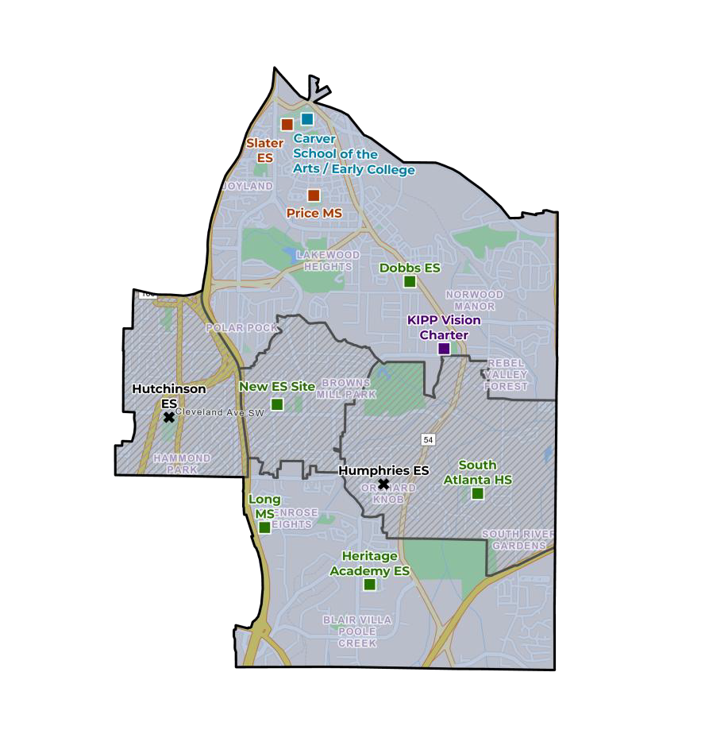
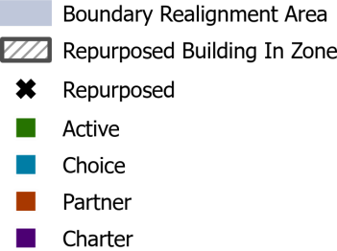



South Atlanta – Primary Scenario
ESPLOST DEPENDENT
Boundary
School(s) | Proposed Action | Resulting Capacity | 2025-2026 Enrollment | 2029-2030 Projected Live-In
Cleveland ES | Replace Cleveland ES on-site. Repurpose Humphries ES and Hutchinson ES. Elementary boundary realignment within the cluster. Slater ES moves from Carver to South Atlanta Cluster. | 700 - 900 | 224 | 2175
Dobbs ES |  | 725 | 312
Heritage Academy ES |  | 675 | 332
Humphries ES |  | 0 | 272
Hutchinson ES |  | 0 | 243
Slater ES |  | 675 | 450
Total |  | 2775 - 2995 | 1833
Realignment
Cleveland
New Cleveland
Humphries
Dobbs
Dobbs
Hutchinson
Heritage Academy
Heritage Academy
Long MS | Accept HS students from Slater ES zone moving to South Atlanta Cluster | 1000 | 601 | 883
Price MS |  | 775 | 226 | 246
South Atlanta HS |  | 1625 | 930 | 1494
New Elementary School at existing Cleveland site
Facility Improvements to Dobbs & Heritage Academy (ESPLOST Dependent)
Facility
Slater ES & Price MS moves from Carver to South Atlanta Cluster Elementary boundary realignment within the cluster
Boundary
Re-Purpose
Humphries ES & Hutchinson ES - TBD
Operational Savings
Reduction of 2 ES Facilities: @ $3m-$4m annually

Slide 35
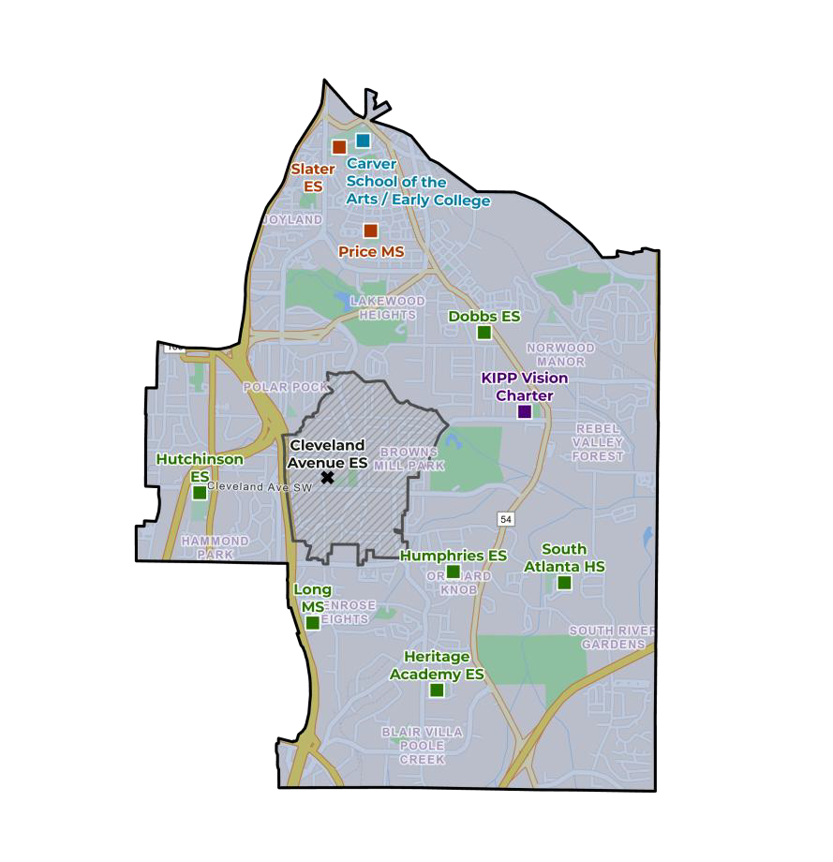
South Atlanta – Secondary Scenario
School(s) | Proposed Action | Resulting Capacity | 2025-2026 Enrollment | 2029-2030 Projected Live-In
Dobbs ES | Repurpose Cleveland ES. Elementary boundary realignment within the cluster. Slater ES moves from Carver to South Atlanta Cluster. | 725 | 312 | 2175
Heritage Academy ES |  | 675 | 332
Cleveland ES |  | 0 | 224
Humphries ES |  | 450 | 272
Hutchinson ES |  | 575 | 243
Slater ES |  | 675 | 450
Total |  | 3100 | 1833
Cleveland
Humphries
Dobbs
Heritage
Academy
Dobbs
Hutchinson
Humphries
Hutchinson
Long MS | Accept HS students from Slater ES zone moving to South Atlanta Cluster | 1000 | 601 | 883
Price MS |  | 775 | 226 | 246
South Atlanta HS |  | 1625 | 930 | 1494
Heritage Academy
Boundary Realignment
Repurpose Cleveland ES
Facility Improvements to Dobbs & Heritage Academy (ESPLOST Dependent)
Facility
Slater ES & Price MS moves from Carver Cluster to South Atlanta Cluster
Elementary boundary realignment within the cluster
Boundary
Re-Purpose
Cleveland ES - TBD
Reduction of 1 ES Facility: @ $1.5m-$2m annually
Operational Savings

Slide 36
Questions?
10/3/2025
35

Slide 37

Thank you

